Slide 1

Statistical Inference

Slide 2
What is statistical influence?
To draw conclusion of entire population based on sample data.

Slide 3
Statistical inference
Estimation
Hypothesis testing

Slide 4
Estimation
Point estimate :- It’s a number that is a best guess for population parameter.
Interval estimate:- Range of value which we expect the parameter to fall.

Slide 5

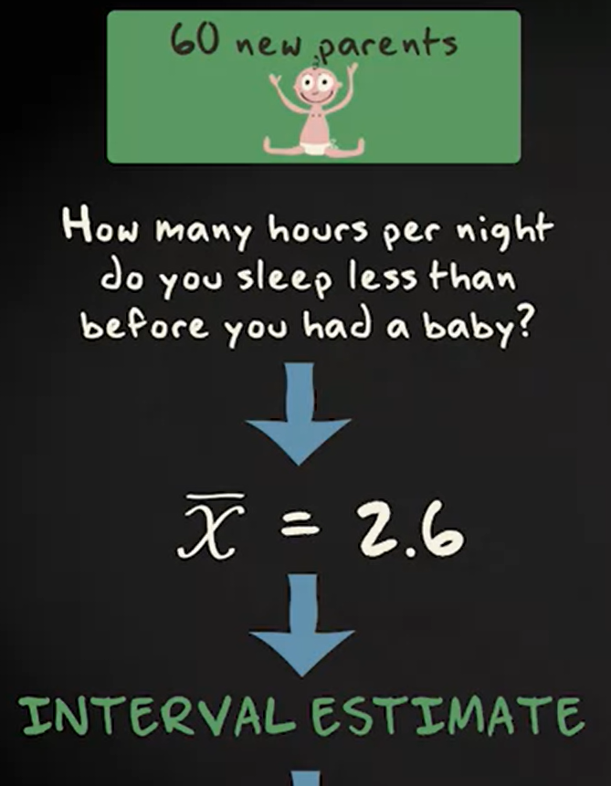




Slide 6
Confidence interval
Probability that interval contains population value. We almost consider for 0.95 cases that is 95% confidence interval.

Slide 7


CI for mean with known population sd

Slide 8
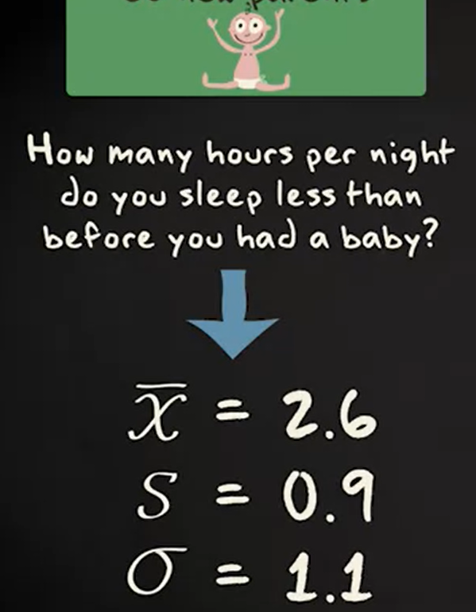

Slide 9
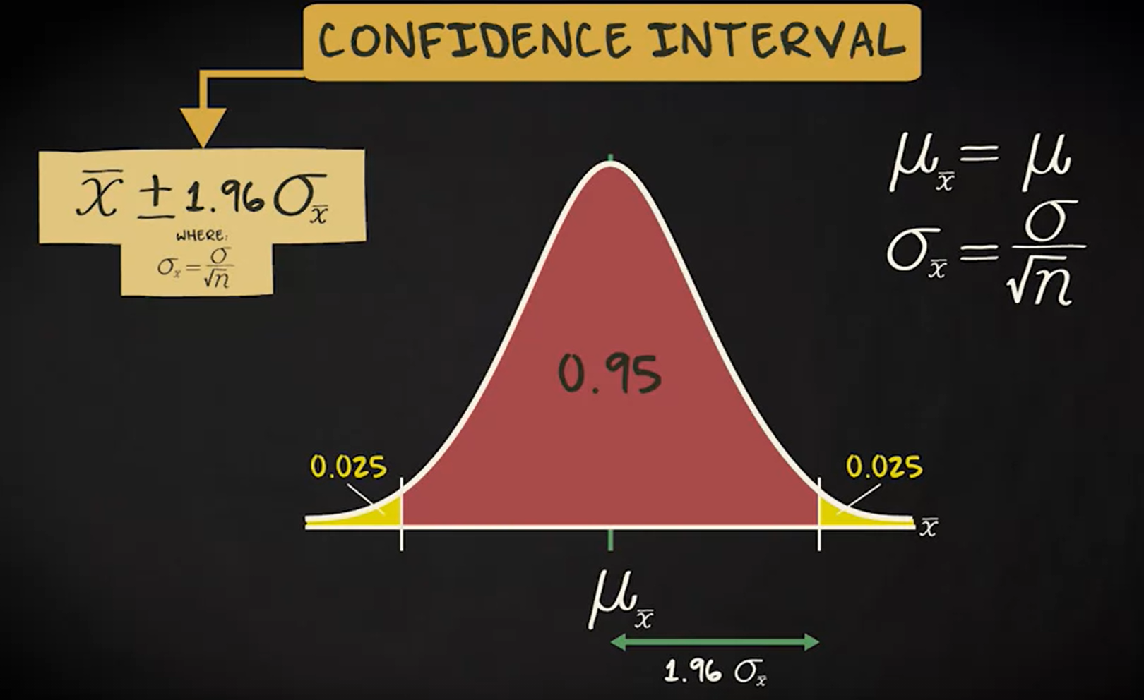

Slide 10
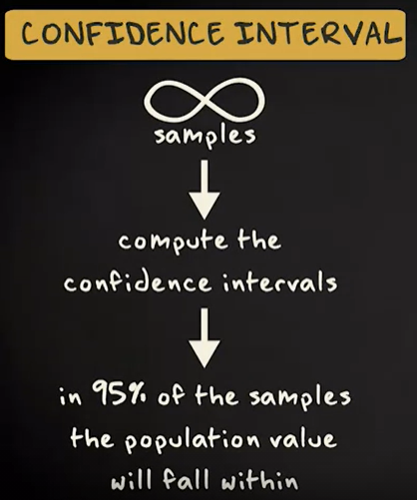
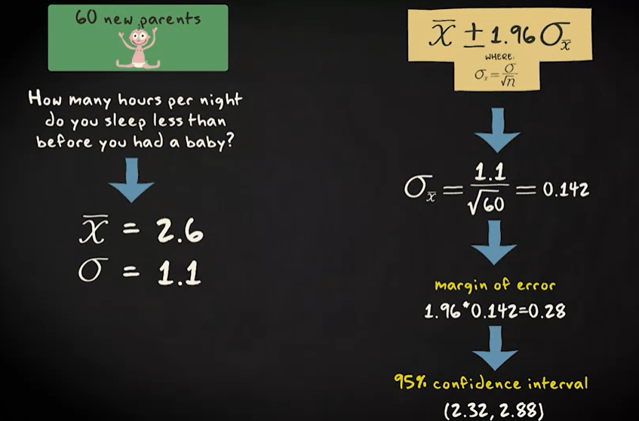

Slide 11



Slide 12
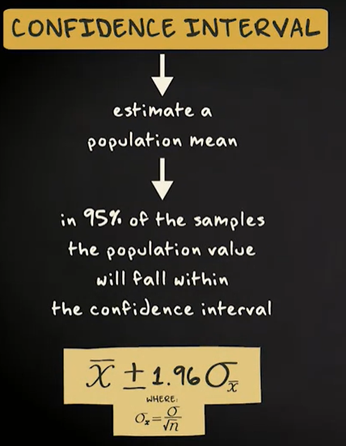
CI for mean with unknown population

Slide 13
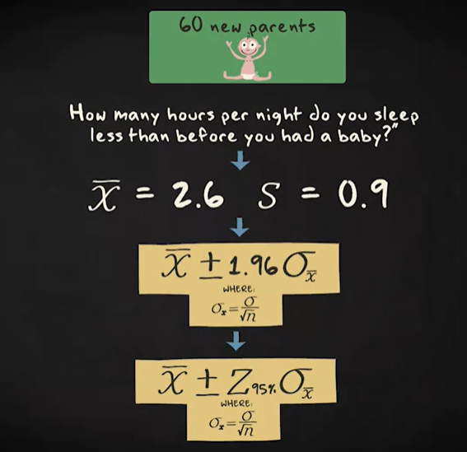
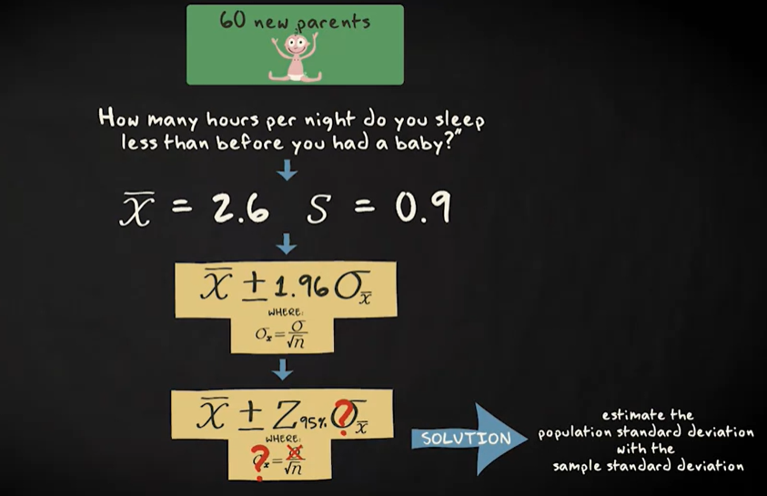
T-distribution

Slide 14
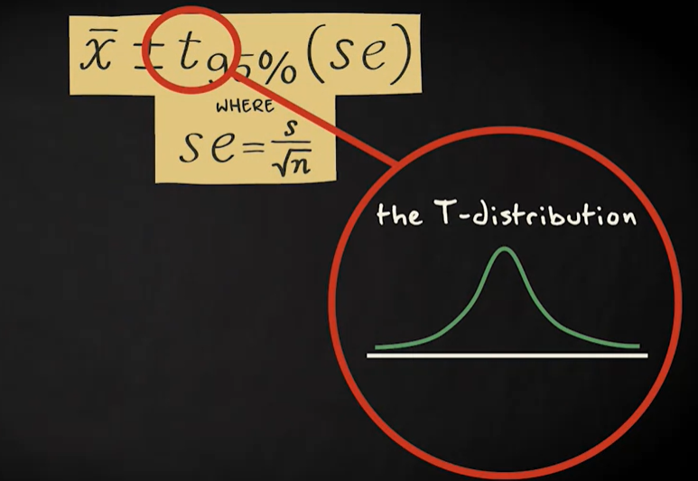
T - distribution

Slide 15
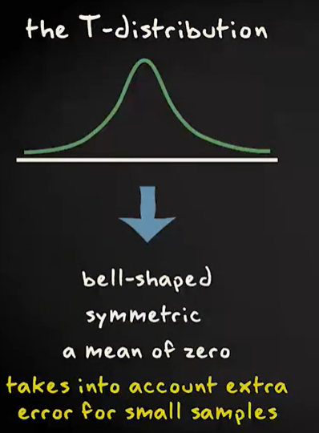
T-distribution

Slide 16
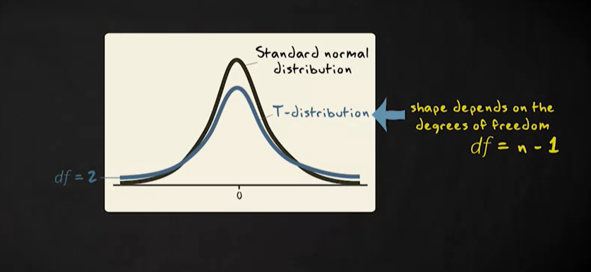
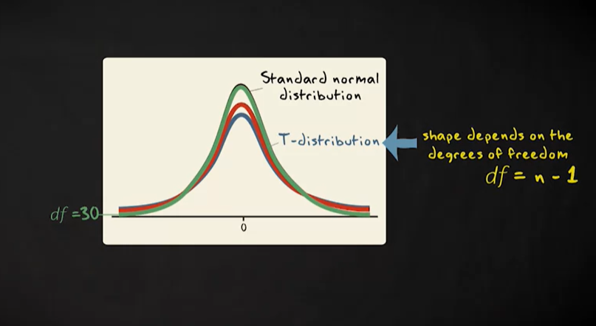
T-distribution

Slide 17
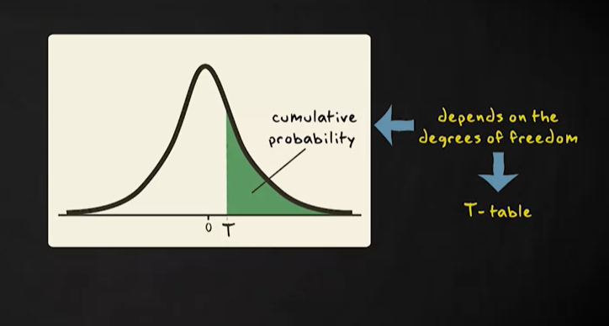
T- distribution

Slide 18
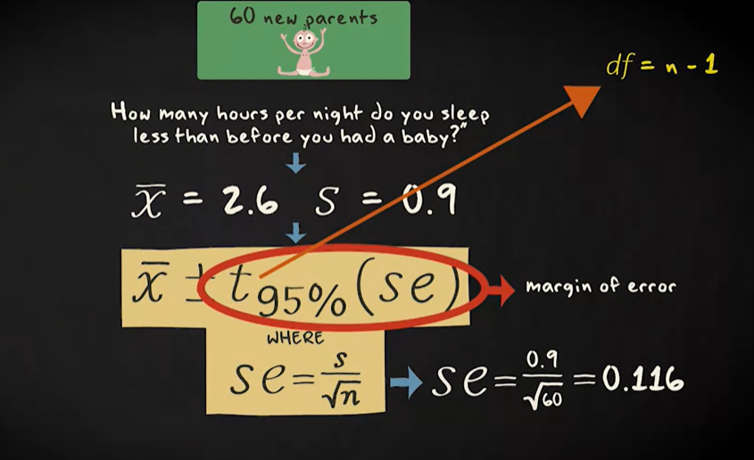
T - distribution

Slide 19
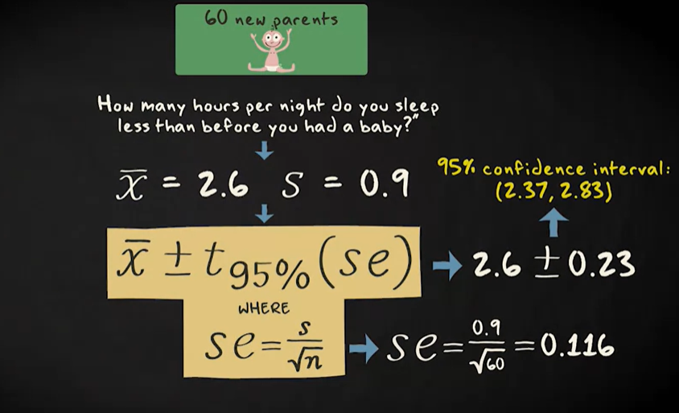
T- distribution

Slide 20
Assumption of Confidence interval
Randomization
Approximately normal population distribution ( t-distribution robust against violence)
Careful about extreme outliers.

Slide 21
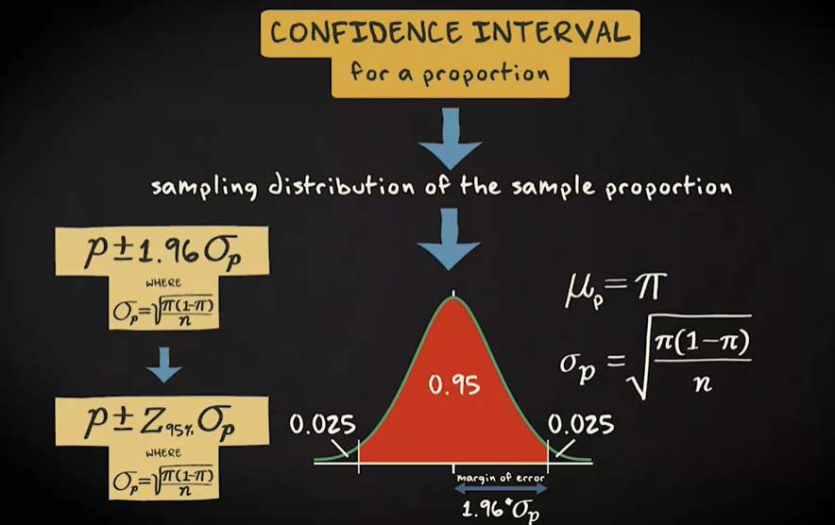
Confidence Interval for proportion

Slide 22
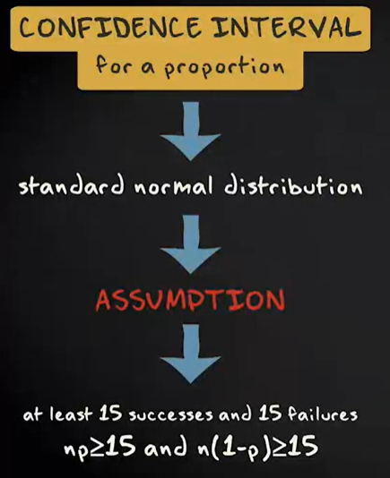
Confidence Interval for proportion

Slide 23
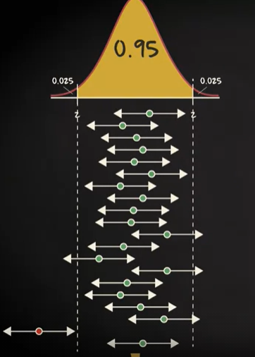
Confidence level
If we draw an infinite number of sample like our actual sample, and for every sample we computer 95% of confidence interval with similar margin of error, 95% of the population value will falls with the confidence range.

Slide 24
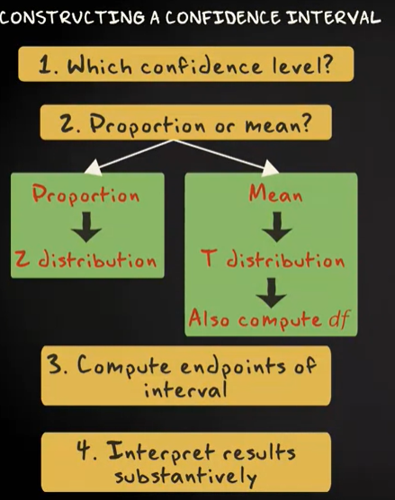
Confidence interval

Slide 25

Choosing the sample size

Slide 26
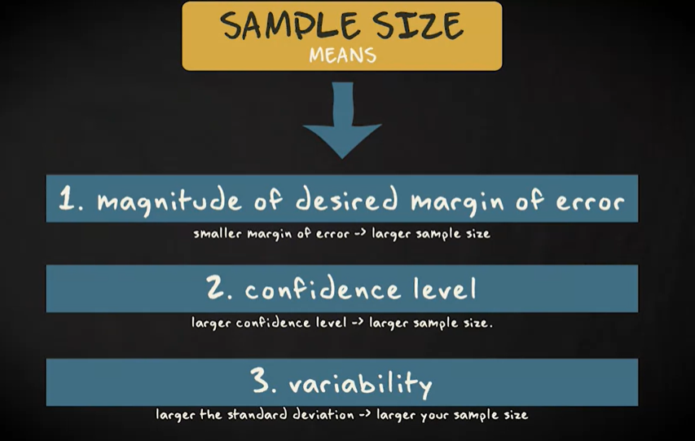
Choosing the sample size

Slide 27
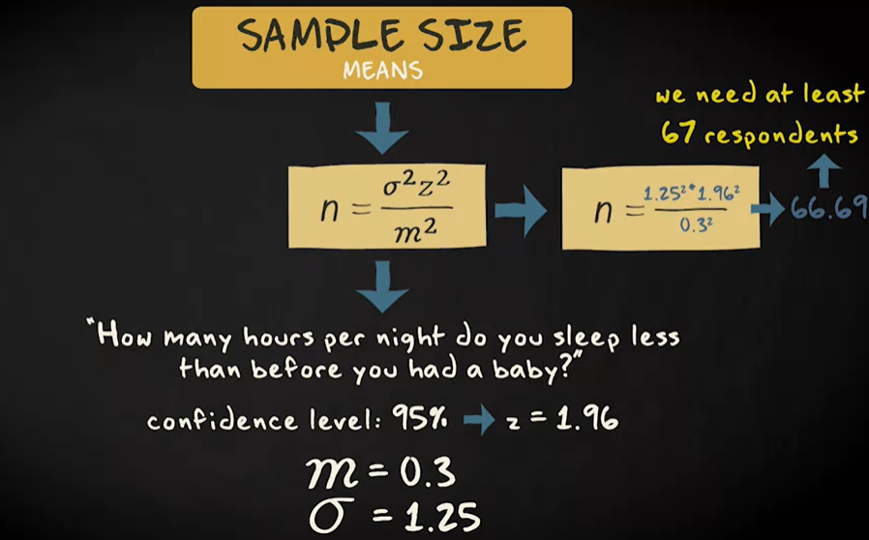
Choosing the sample size

Slide 28
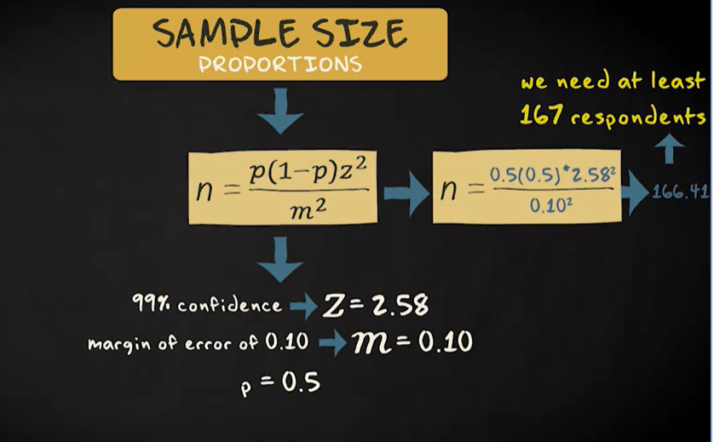
Choosing the sample size

Slide 29

Computing sample size

